Slide 1

React
React · Lecture 1
Lecture 1 · Why React, and your first app
1
Notes:
What the next 9 lectures lead to: building real multi-page React apps.

Slide 2
Plain JavaScript vs React
React · Lecture 1
In plain JS: data changes → find the element → update it by hand
let count = 0;
const countEl = document.querySelector('#count');
const button = document.querySelector('#plus');
button.addEventListener('click', () => {
count++;
countEl.textContent = count;
});
2
Notes:
Count how many lines only keep the screen in sync with data. That is the pain React removes. Point at the amber line: it only copies data to the screen. The two querySelector lines exist only to find elements.

Slide 3

React in one line
React · Lecture 1
UI = f(state)
Data in → screen out
state (data)
your component
UI (screen)
3
Notes:
Change the data, React redraws. You describe the result, not the steps.

Slide 4
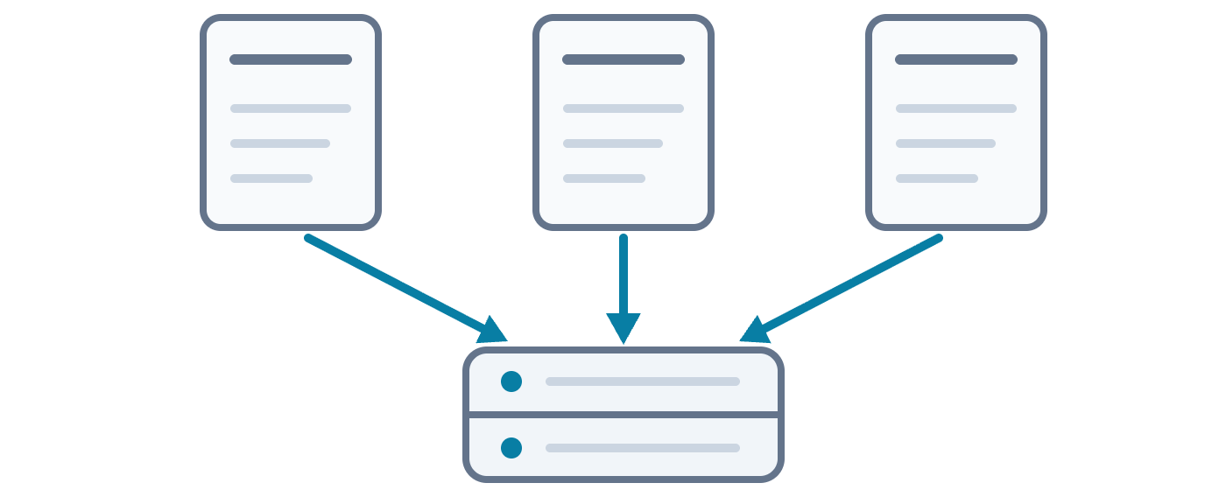
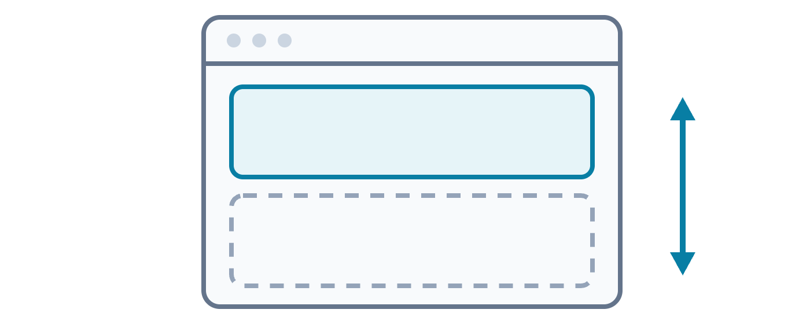
Multi-page vs SPA
React · Lecture 1
Multi-page
SPA
Every click = a new page from the server
One page. JavaScript swaps the view.
4
Notes:
Show the Network tab on a normal site vs Gmail. One sentence each on pros and cons.

Slide 5

Tooling: Vite
React · Lecture 1
A new React project in one minute
npm create vite@latest my-app
cd my-app
npm install
npm run dev
5
Notes:
Vite gives a dev server and a build step. node_modules: never edit, never push. Live: in the prompts choose React, then JavaScript. Open the local URL Vite prints (usually http://localhost:5173).

Slide 6
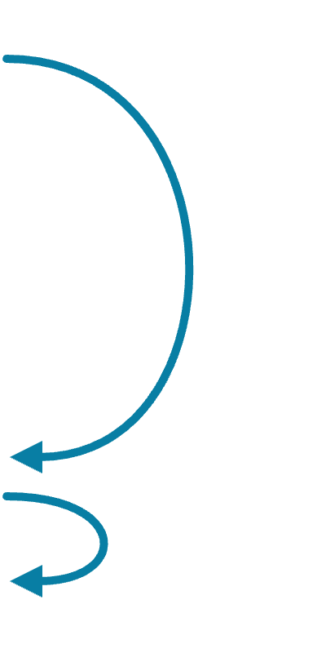
Project anatomy
React · Lecture 1
Where things live
my-app/
├── index.html
1
├── package.json
├── public/
└── src/
├── main.jsx
2
└── App.jsx
3
6
Notes:
index.html loads main.jsx; main.jsx puts App into div#root. Live: open the three files in this order: 1, 2, 3.

Slide 7
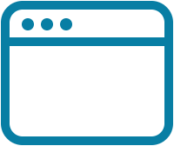

Browsers don't read JSX
React · Lecture 1
A tool translates JSX into plain JavaScript
React.createElement(
<h1>Hello</h1>
Babel
'h1', null, 'Hello'
(inside Vite)
)
7
Notes:
Like translating a letter for someone who reads only one language. Vite does it for us.

Slide 8
Same element, two ways
React · Lecture 1
JSX = nicer syntax for function calls
Function call
JSX
React.createElement(
<h1 className="title">
'h1',
=
Hello
{ className: 'title' },
</h1>
'Hello'
)
8
Notes:
Three arguments: tag, props, children. We'll only write JSX from now on. The colors match on both sides: tag, props, children.

Slide 9
Your first component
React · Lecture 1
A component is a function that returns UI. Its name starts with a capital letter.
function Greeting() {
localhost:5173
return <h1>Hello, React!</h1>;
}
Hello, React!
export default Greeting;
9
Notes:
Capital letter is required. Lowercase = treated as an HTML tag. Live: rename it to greeting and show that nothing appears on the page.

Slide 10

Homework
React · Lecture 1
Build a profile card
New Vite project, alone
Photo, name, short bio, 2 links
Push to GitHub
10

